Slide 1



DIYALA UNIVERSITY
COLLEGE OF ENGINEERING
DEPARTMENT OF COMMUNICATIONS ENGINEERING
Mathematics- II
$$2^{nd }Lecture$$
First Year
lecturer
Wisam Hayder
2021

Slide 2
First-Order Differential Equations
First-Order Linear Equations
A first-order linear differential equation is one that can be written in the form
(1)
Where P and Q are continuous functions of x. Equation (1) is the linear equation’s standard form.
Since the exponential growth decay equation can be put in the standard form
Notes:
aaa

Slide 3


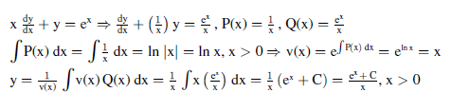
We see it is a linear equation with
Ex.1: Solve the differential equations
Sol.

Slide 4
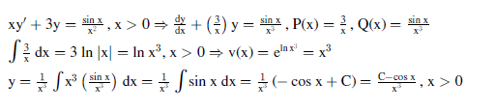
First-Order Differential Equations
Ex.2:
Sol.
Notes:
aaa

Slide 5
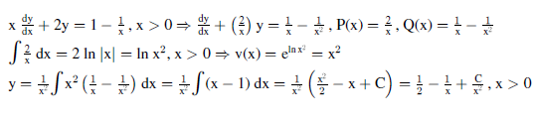
First-Order Differential Equations
Ex.3:
Sol.
Notes:
aaa

Slide 6


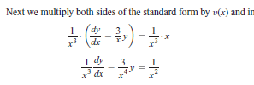
First-Order Differential Equations
Ex.4: Solve the equation
Solution

Slide 7


Slide 8
First-Order Differential Equations
Homeworks : A Solve the differential equations
1-
2-
3-
4-
Notes:
aaa

Slide 9
First-Order Differential Equations
Homeworks: B Solve the initial value problems
1-
2-
3-
Notes:
aaa

Slide 10
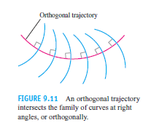
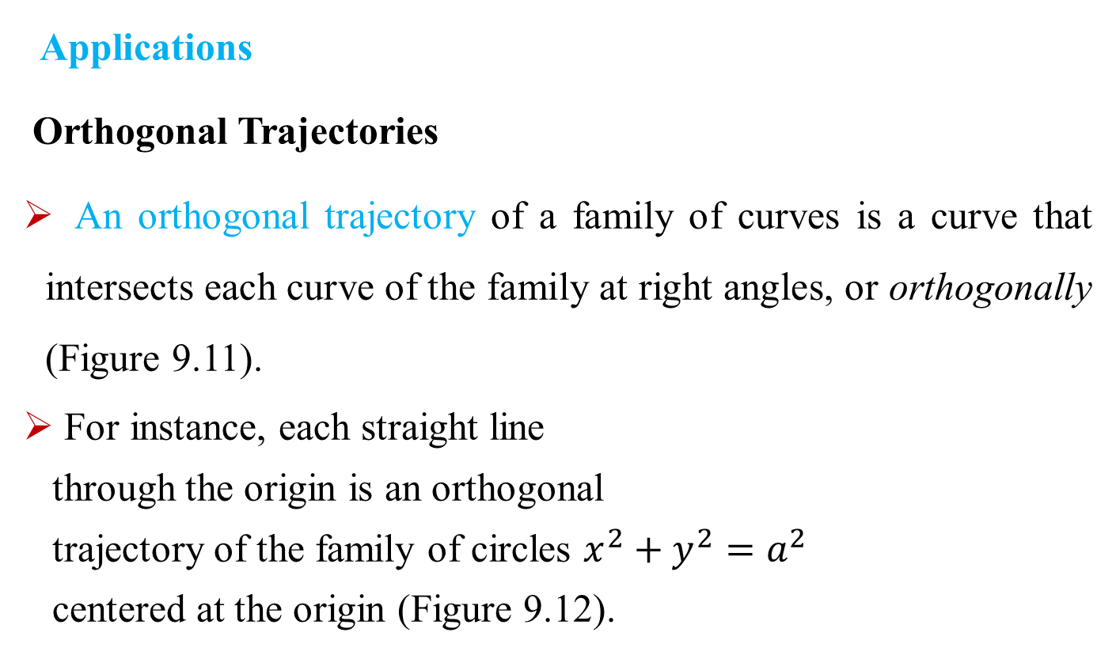
First-Order Differential Equations
Applications
Orthogonal Trajectories
An orthogonal trajectory of a family of curves is a curve that intersects each curve of the family at right angles, or orthogonally (Figure 9.11).
For instance, each straight line
through the origin is an orthogonal
trajectory of the family of circles $x^{2}+y^{2}=a^{2}$
centered at the origin (Figure 9.12).
Notes:
aaa

Slide 11
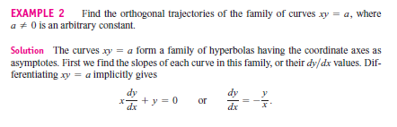
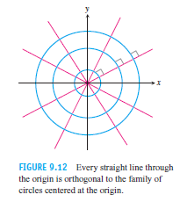
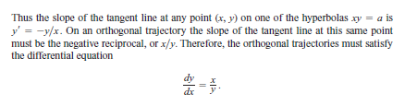
First-Order Differential Equations
Notes:
aaa

Slide 12
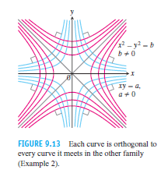
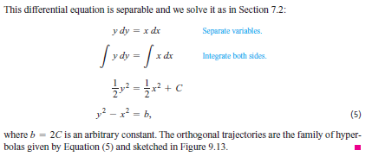
First-Order Differential Equations
Notes:
aaa

